Slide 1
Automated Indefinite Delivery Contract (AIDC)
Christina Geobert,
Procurement Analyst,
November, 5 2024

Slide 2
AIDC – Automated Indefinite Delivery Contract
Automated, single material long-term contract for stocked items we purchase multiple times per year
Below the simplified acquisition threshold ($250K)
1 year base with automated successor logic; no option year(s)
Solicitation requirements:
  Open for 14 days
  No phased delivery
  No quantity ranges
• Evaluation:
  Based on single price decision
  Surplus offers not allowed
  Alternate offers not allowed
Benefits for YOU!
less quoting and more opportunities
for long-term contracts!
Benefits for US!
reduced administrative lead-time
and increased military customer
support!

Slide 3
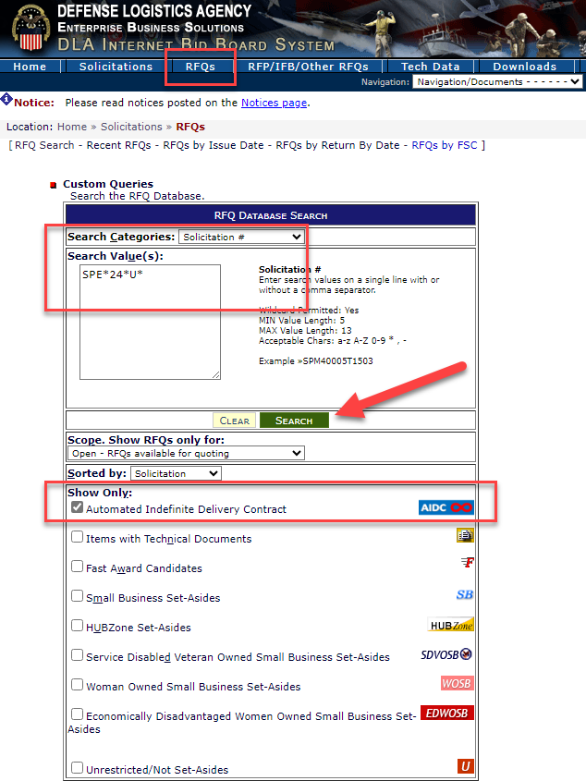
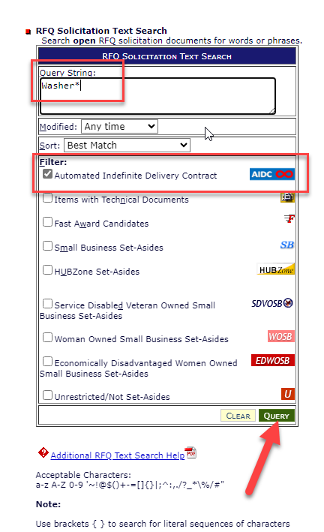
AIDC –Automated Indefinite Delivery Contract
How do I Search for AIDC?

Slide 4
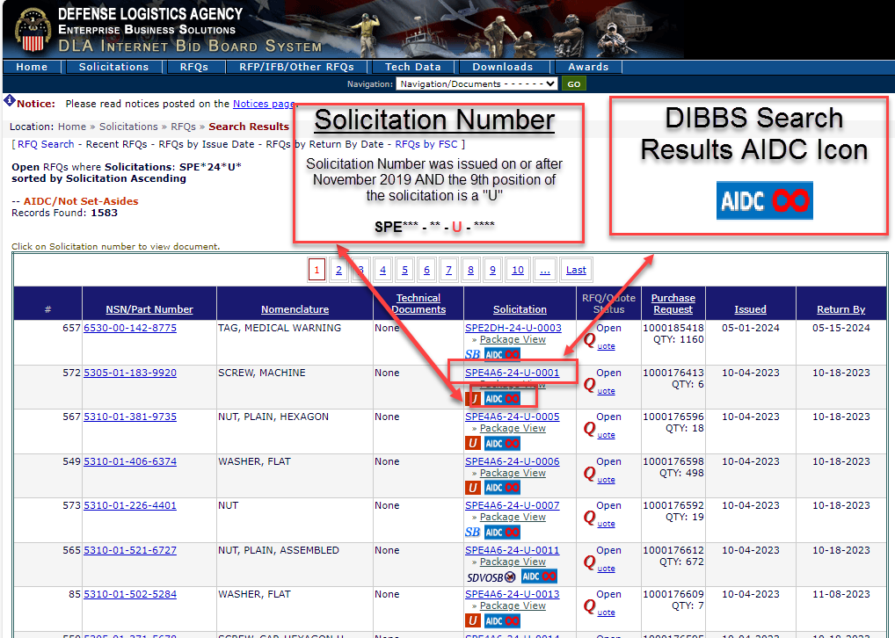
AIDC –Automated Indefinite Delivery Contract
How Do I Identify AIDC?

Slide 5
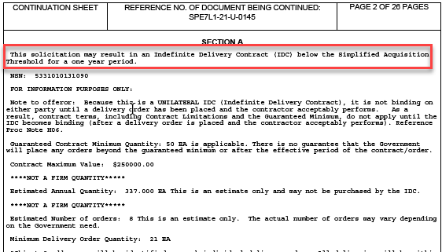
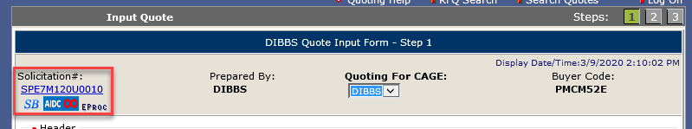
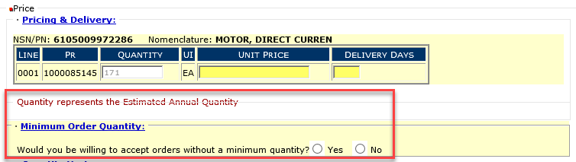
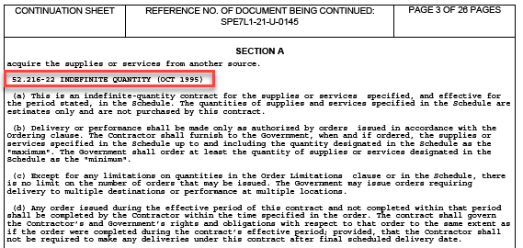
AIDC –Automated Indefinite Delivery Contract
How Do I Identify AIDC?
SF18 Solicitation Document
(Pages 2-4)
DIBBS Quote Form

Slide 6
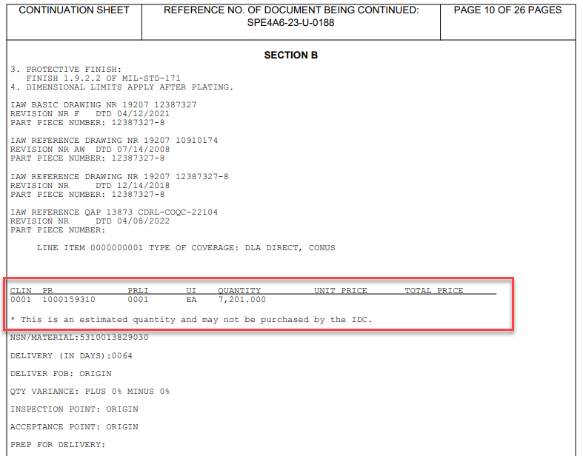
AIDC –Automated Indefinite Delivery Contract
AIDC Quantity
Suppliers should quote the full quantity on the basic contract.
Price breaks are not accepted at this time.
This QTY is an estimate of what will be purchased by the IDC.
Example: QTY is 7,201 EA

Slide 7
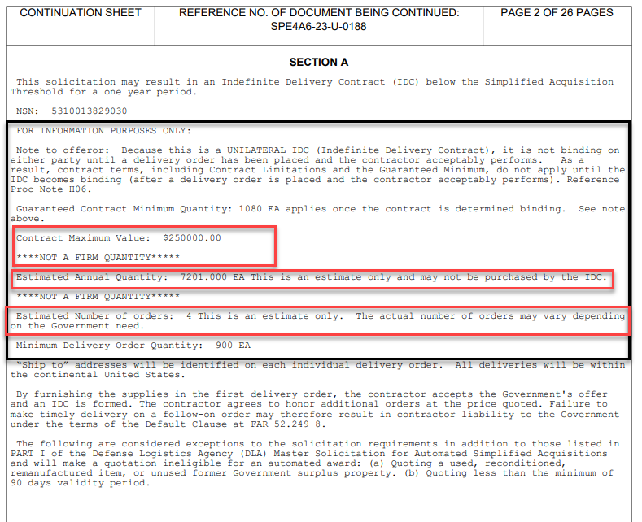
AIDC –Automated Indefinite Delivery Contract
Estimated Annual Quantity
Unilateral IDC
  Not binding until a DO has been placed and the contractor acceptable performs.
Contract Maximum Value
  SAT ($250,000)
Estimated Annual Quantity
  Not a firm quantity
  Example: 7,201 EA
Estimated Number of orders
  Example: 4

Slide 8
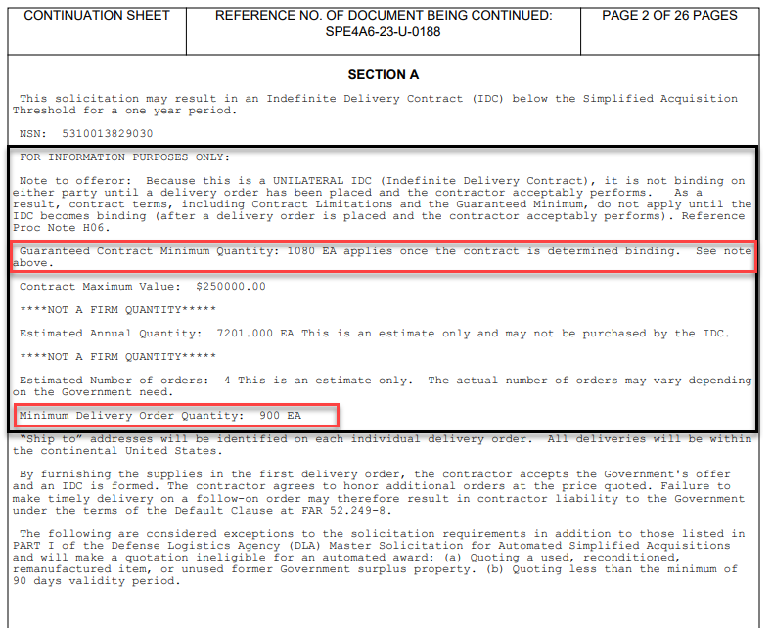
AIDC –Automated Indefinite Delivery Contract
Guaranteed Contract Min and Delivery Order Min
Guaranteed Contract Minimum
  A percent of the annual forecasted demand
Delivery Order Minimum
  Is ½ of the estimated delivery order quantity.
  Contractors will have an option to state if they will accept “no minimum” on the quote form.

Slide 9
AIDC –Automated Indefinite Delivery Contract Clauses and a Procurement Notes
WARFIGHTER ALWAYS
Clauses and a Procurement Note Added:
• 52.216-19 ORDER LIMITATIONS (OCT 1995)
• 52.216-22 INDEFINITE QUANTITY (OCT 1995)
• 52.216-18 ORDERING (AUG 2020)
• H06 Unilateral Indefinite-Delivery Contract (IDC) Below the Simplified Acquisition Threshold (SAT) (SEP 2017)
7 Source: Director’s Office DLA Slide Template As of August 26, 2020

